Slide 1
HIV Drugs
Spreadsheet Documentation
Click below for
Impact Summary Link

Slide 2
General Information
Contains:
Summary of World Health Organization (WHO) Groups and Geographical Regions
HIV-based DALY scores for each country/region
Types of drugs and treatment regiments (1st, 2nd or 3rd) administered
HIV prevalence and treatment coverage per country
HIV Treatment efficacy data
Global Health Impact scores for various HIV drugs
Company rankings by impact of HIV drugs

Slide 3
Definitions
WHO region: designated regions provide by the World Health Organization
Taken from http://www.who.int/neglected_diseases/preventive_chemotherapy/sch/en/
DALY: Disability-Adjusted Life Years (D)
“burden” of the disease
Years of life taken by disease from population if it was in a healthy state free from disease
Treatment Coverage (θ):
ratio btwn number of people receiving treatment to the number of people diagnosed with the disease
Efficacy (e):
percentage of population receiving treatment that were actually cured
Data generated from WHO, UNAID database

Slide 4
Calculating Impact Score
I= (D* θ*E )/(1-θ*E)
= total years of life saved when administering effective treatment

Slide 5
Drugs
3TC | Lamivudine
d4T | Stauvidine
ddl | Didanosine
AZT | Zidovudine
ABC | Abacavir
EFV | Efavirenz
TDF | Tenofovir
FTC | Emtricitabine
LPV/r | Lopinavir/Ritonavir
ATV/r | Atazanafir/Ritonavir
NVP | Nevirapine
NFV | Nelfinavir

Slide 6
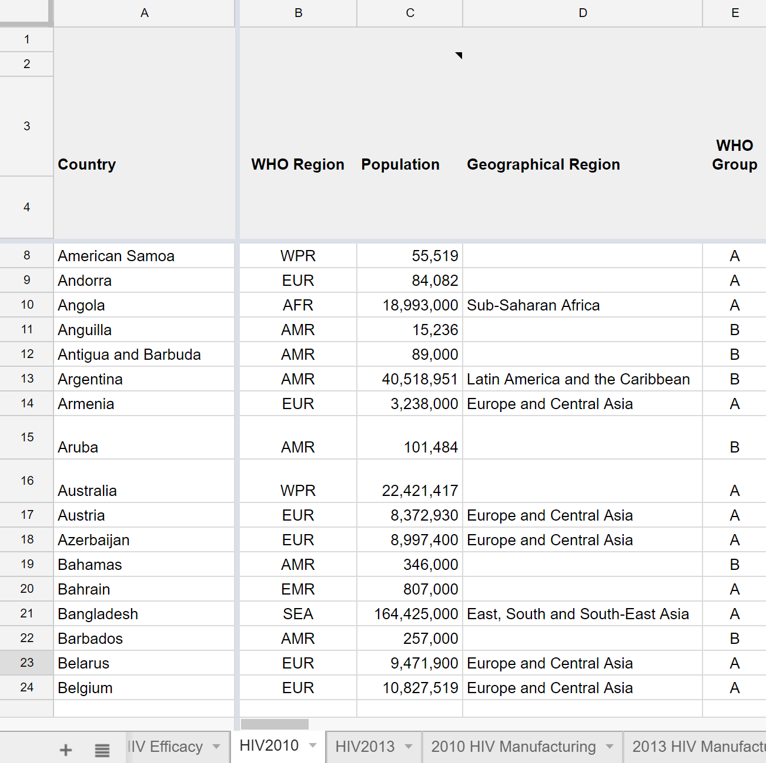
Country Data
Column A: Country
Column B: Countries sorted by WHO Region
Column C: Population
Column D: Geographical Region
E.g: AMR = “Central America,” “Latin America”
Column E: WHO Group
Group A= Low and middle income countries outside the Americas (AFR, EUR, SEA, WPR)
Group B= Low and middle income countries within the Americas (AMR)

Slide 7
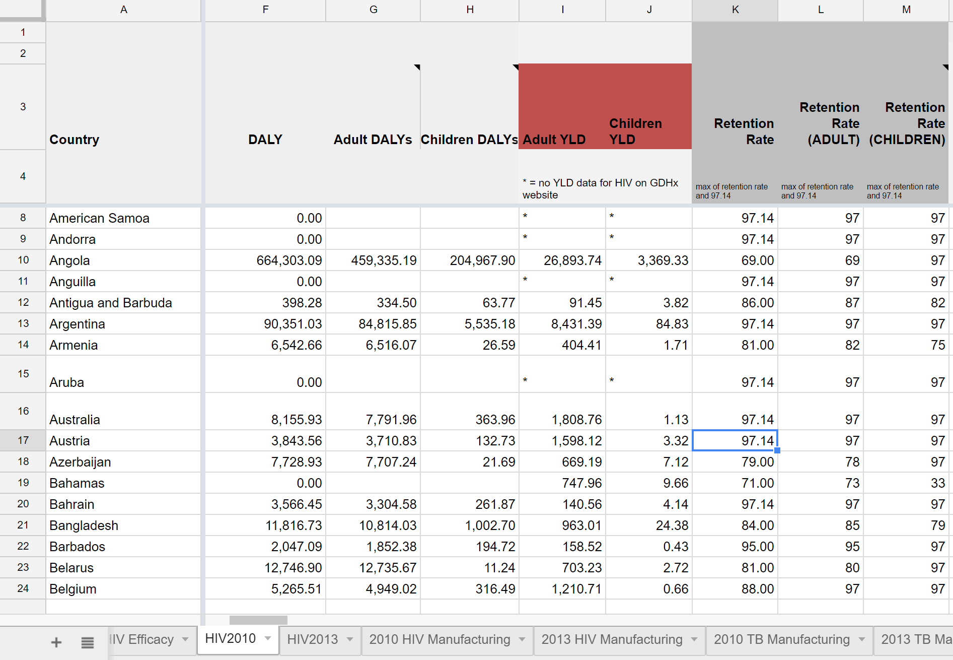
DALY Data
Column F: DALY score for the country
Column G: Adult DALYs lost by HIV (age 15+)
Column H: Children DALYs lost by HIV (age <15)
Column I: Adult Years Lost due to Disability
YLD= prevalence*disability weight
Column J: Children Years Lost due to Disability
Column K: Retention Rate (max=97.14%)
Column L: Adult Retention Rate
Column M: Children Retention Rate

Slide 8
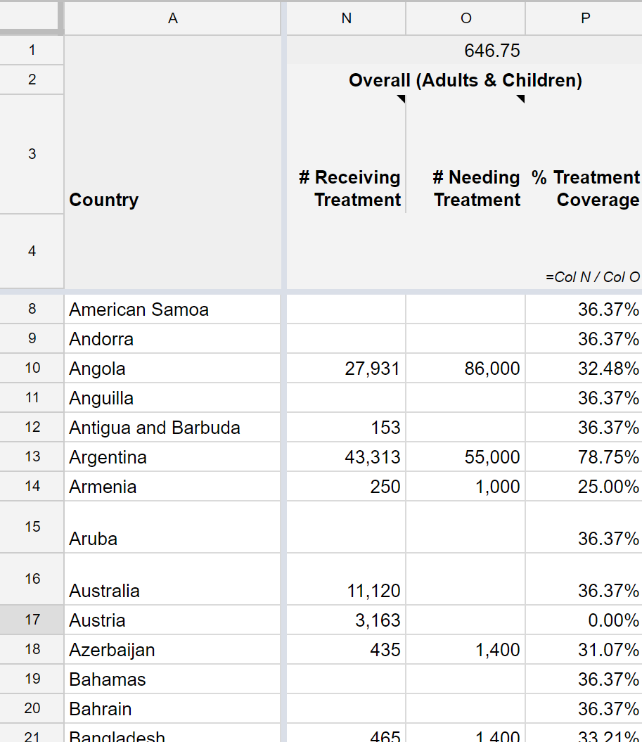
Treatment Coverage Data
Data extracted from databases and studies if available.
If not available, the efficacy data from countries with data will be averaged.
Column N: Population receiving treatment
Column O: Population needing treatment
Column P: Treatment Coverage (θ)
= Col N/ Col O

Slide 9
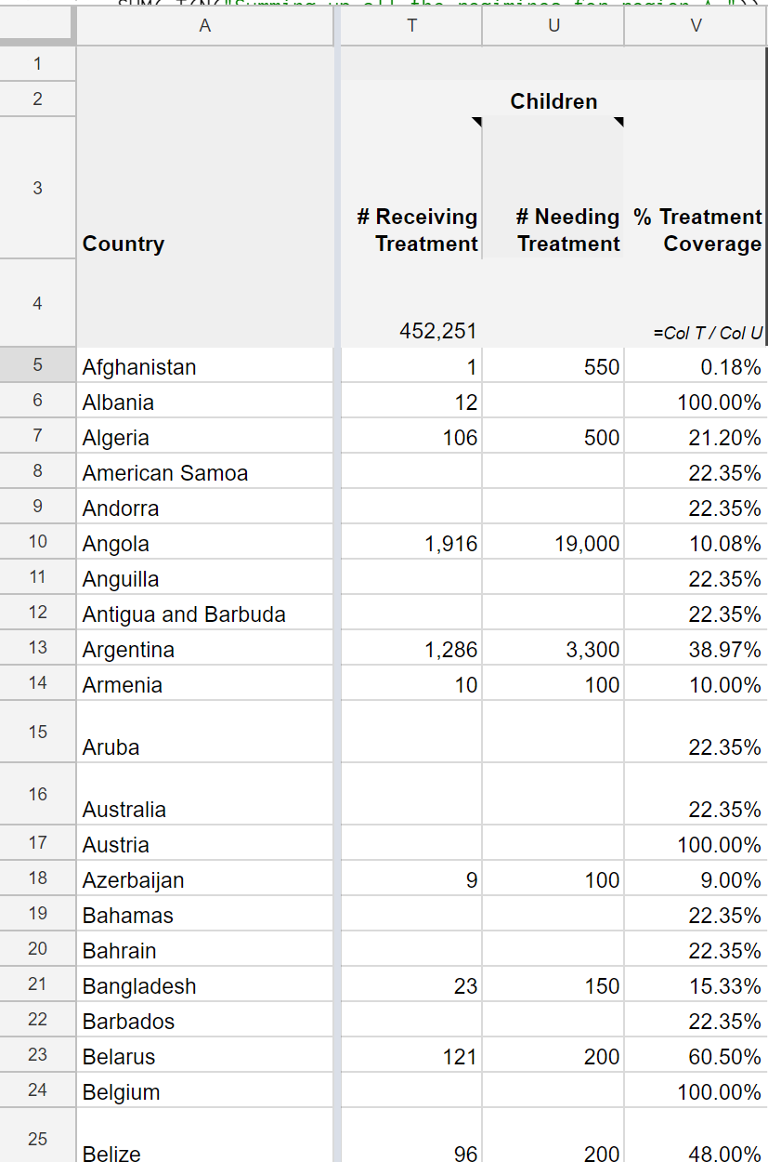
Age Group Treatment Coverage Data
Column T: Children Population receiving treatment
Column U: Children Population needing treatment
Column V: Treatment Coverage (θ)
= Col T/ Col U

Slide 10
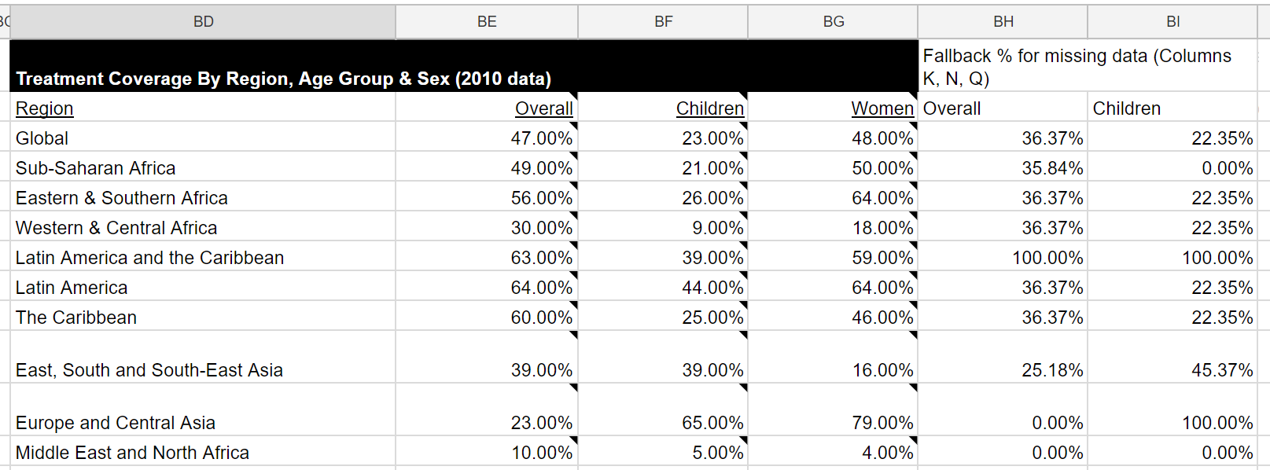
Age Group Treatment Coverage Data
E.g: Cell V5: In Afghanistan, 1/550 [T5/U5], or 0.18% of children needing HIV treatment are receiving treatment.
=IF((IFERROR(($T5/$U5),IFERROR(VLOOKUP($D5,$BD$16:$BI$27,6,FALSE),$BI$18))>1),1,IFERROR(($T5/$U5),IFERROR(VLOOKUP($D5,$BD$16:$BI$27,6,FALSE),$BI$18)))
The command states to divide T5 by U5, if the value in the 6th column in the range BD16:BI 27 (column BI) that corresponds to cell D5 (East, South and South-East Asia) is greater than 1. Otherwise, use global average (BI18).

Slide 11
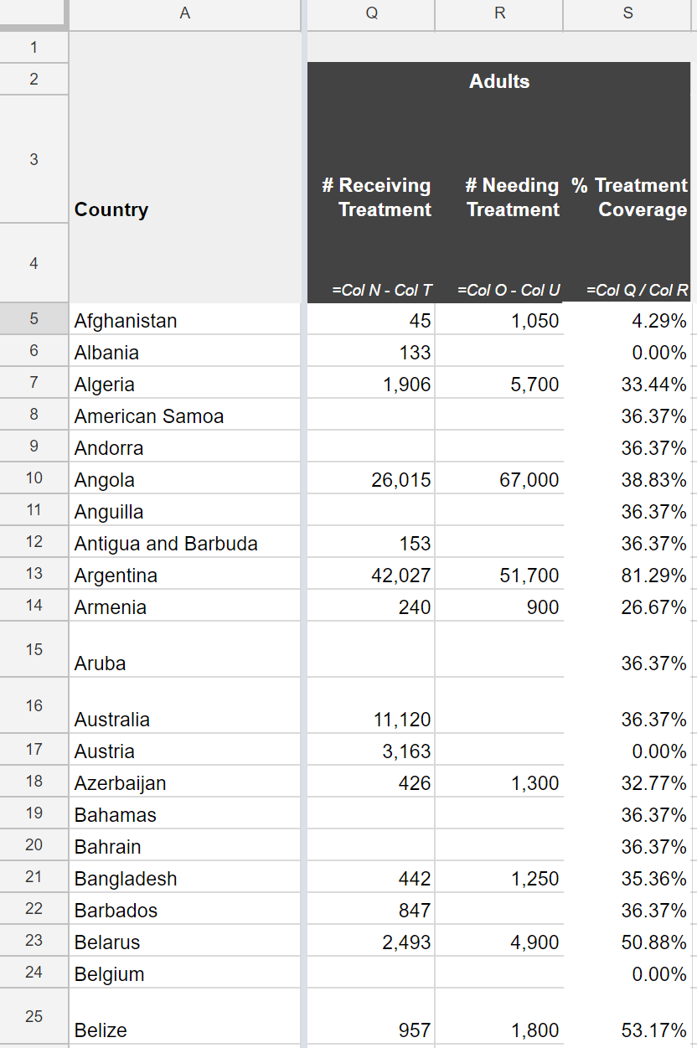
Age Group Treatment Coverage Data
Column Q: Adult Population receiving treatment
= Col N - Col T
Column R: Adult Population needing treatment
= Col O – Col U
Column S: Adult Treatment Coverage (θ)
= Col Q/ Col R

Slide 12
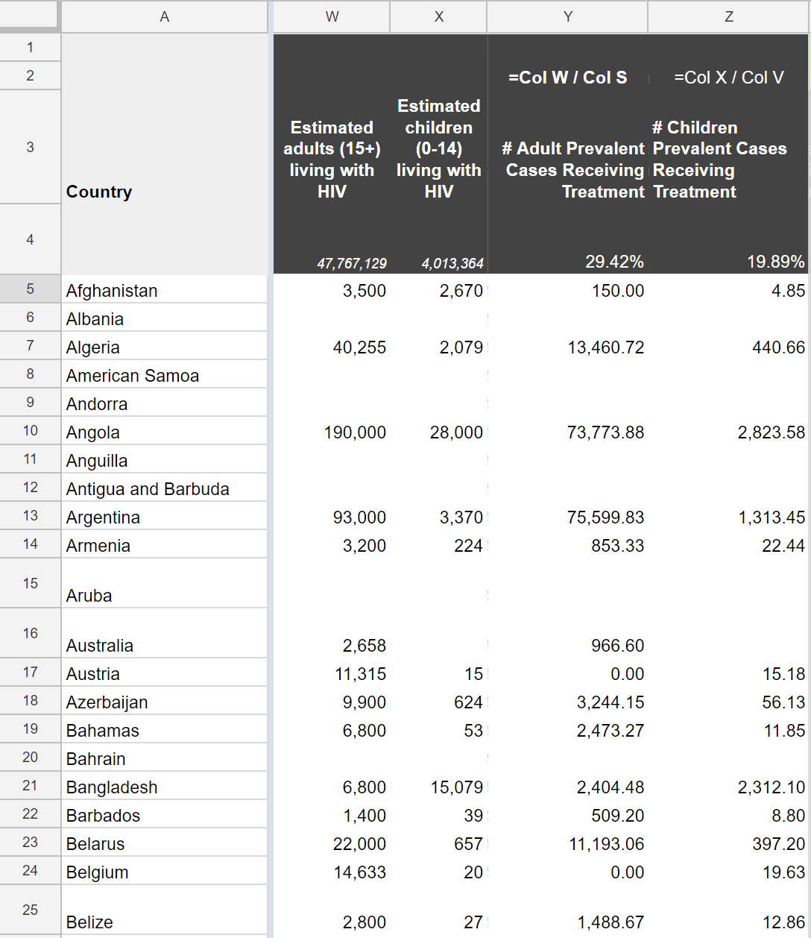
Age Group Treatment Coverage Data
Column W: Estimated # of Adults Living With HIV (Prevalence)
Column X: Estimated # of Children Living With HIV (Prevalence)
Column Y: Percentage of Prevalent Adult Cases Receiving Treatment
= Col W/ Col S
Column Z: Percentage of Prevalent Children Cases Receiving Treatment
= Col X/ Col V

Slide 13
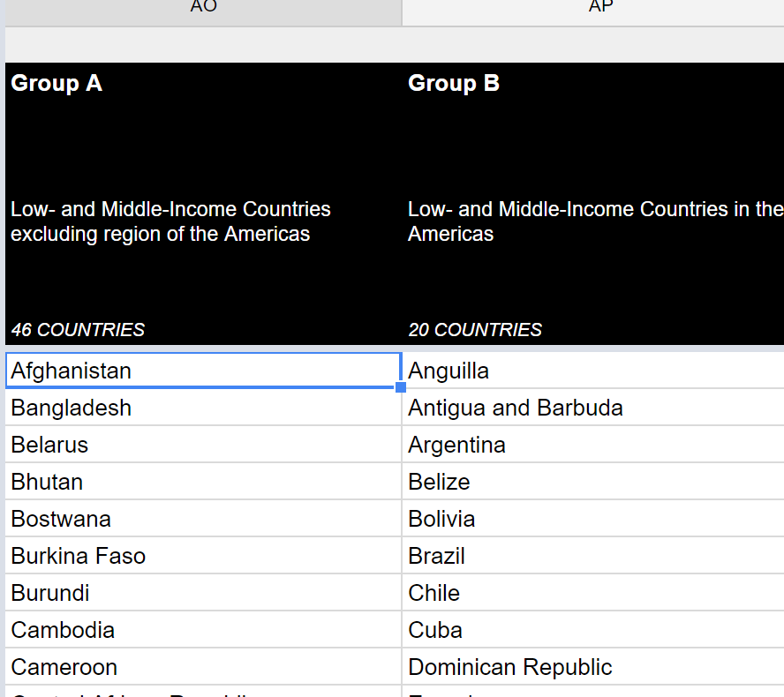
WHO Group Data
Column AO: List of Group A Countries
Outside Americas (AFR, EMR, EUR, SEA, WPR )
Column AP: List of Group B Countries
Within Americas (AMR)

Slide 14
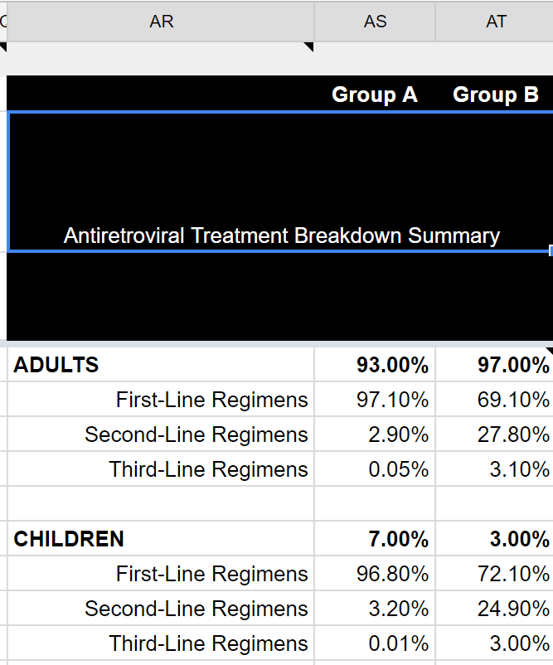
Antiretroviral Treatment Breakdown Summary
Column AR: Regimens for Adult or Children (1st, 2nd or 3rd)
Column AS: Percentage of Adults/Children Receiving that Line of Treatment in Group A countries
Column AT: Percentage of Adults/Children Receiving that Line of Treatment in Group B countries
E.g: Of all the people in Group A countries receiving HIV treatment, 93% are adults and 7% are children. Of the adults receiving treatment, 97.1% are using 1st line regimens, 2.9% are using 2nd line, and 0.05% are using 3rd line.

Slide 15
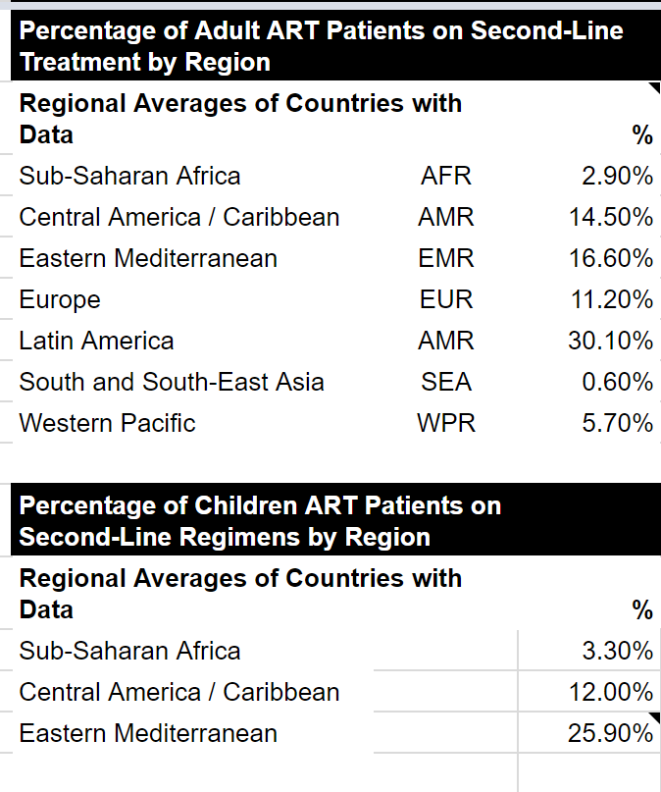
Antiretroviral Treatment Breakdown Summary
Column AR-AT (Rows 15-33): Percentage of adults and children in each region receiving 2nd line treatment

Slide 16
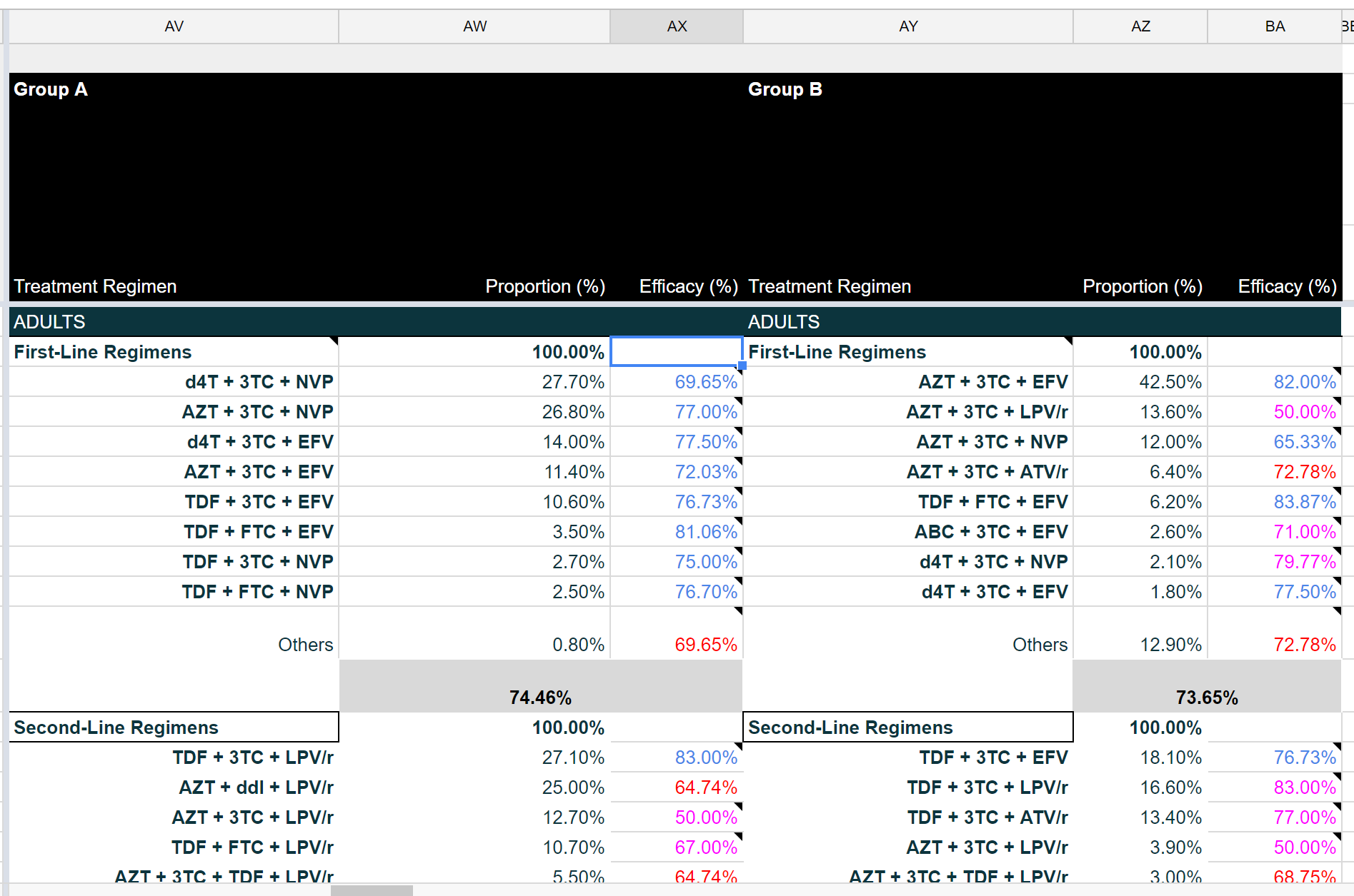
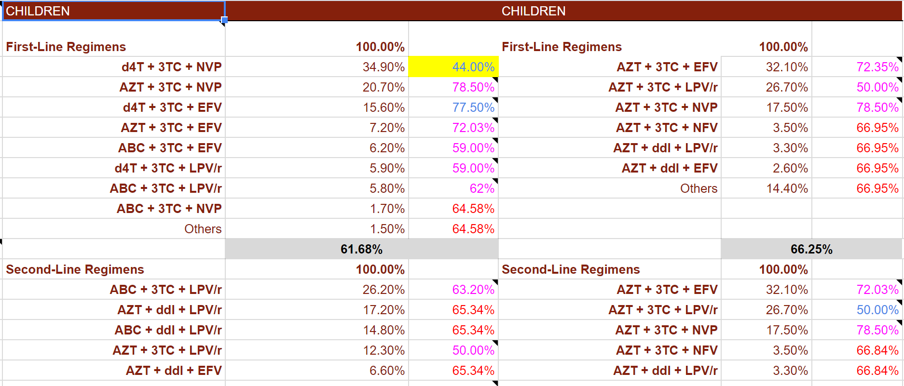
HIV Efficacy Data
Column AV: 1st and 2nd line adult regiments for Group A countries
Column AW: proportion of using specific regiment out of all 1st/2nd adult regiments
Column AX: Efficacy of regiment
Column AY-BA: Same as AV-AX for Group B countries
E.g: Recall that 97.1% of adults in Group A countries use first-line regimens. 27.7% of those first-line regimens are d4T + 3TC + NVP. d4T + 3TC + NVP works on 69.95% of patients treated with this regimen.

Slide 17
HIV Efficacy Data
E.g: Recall that 97.1% of adults in Group A countries use first-line regimens. 27.7% of those first-line regimens are d4T + 3TC + NVP. d4T + 3TC + NVP works on 69.95% of patients treated with this regimen.
Formula for Efficacy of d4T + 3TC + NVP (a 1st line regiment) for adults in a Group A country=
Percentage of adults using 1st line regimens * Proportion of 1st line regimens attributed to d4T + 3TC + NVP * Efficacy of d4T + 3TC + NVP = AS6*AV7*AW7

Slide 18
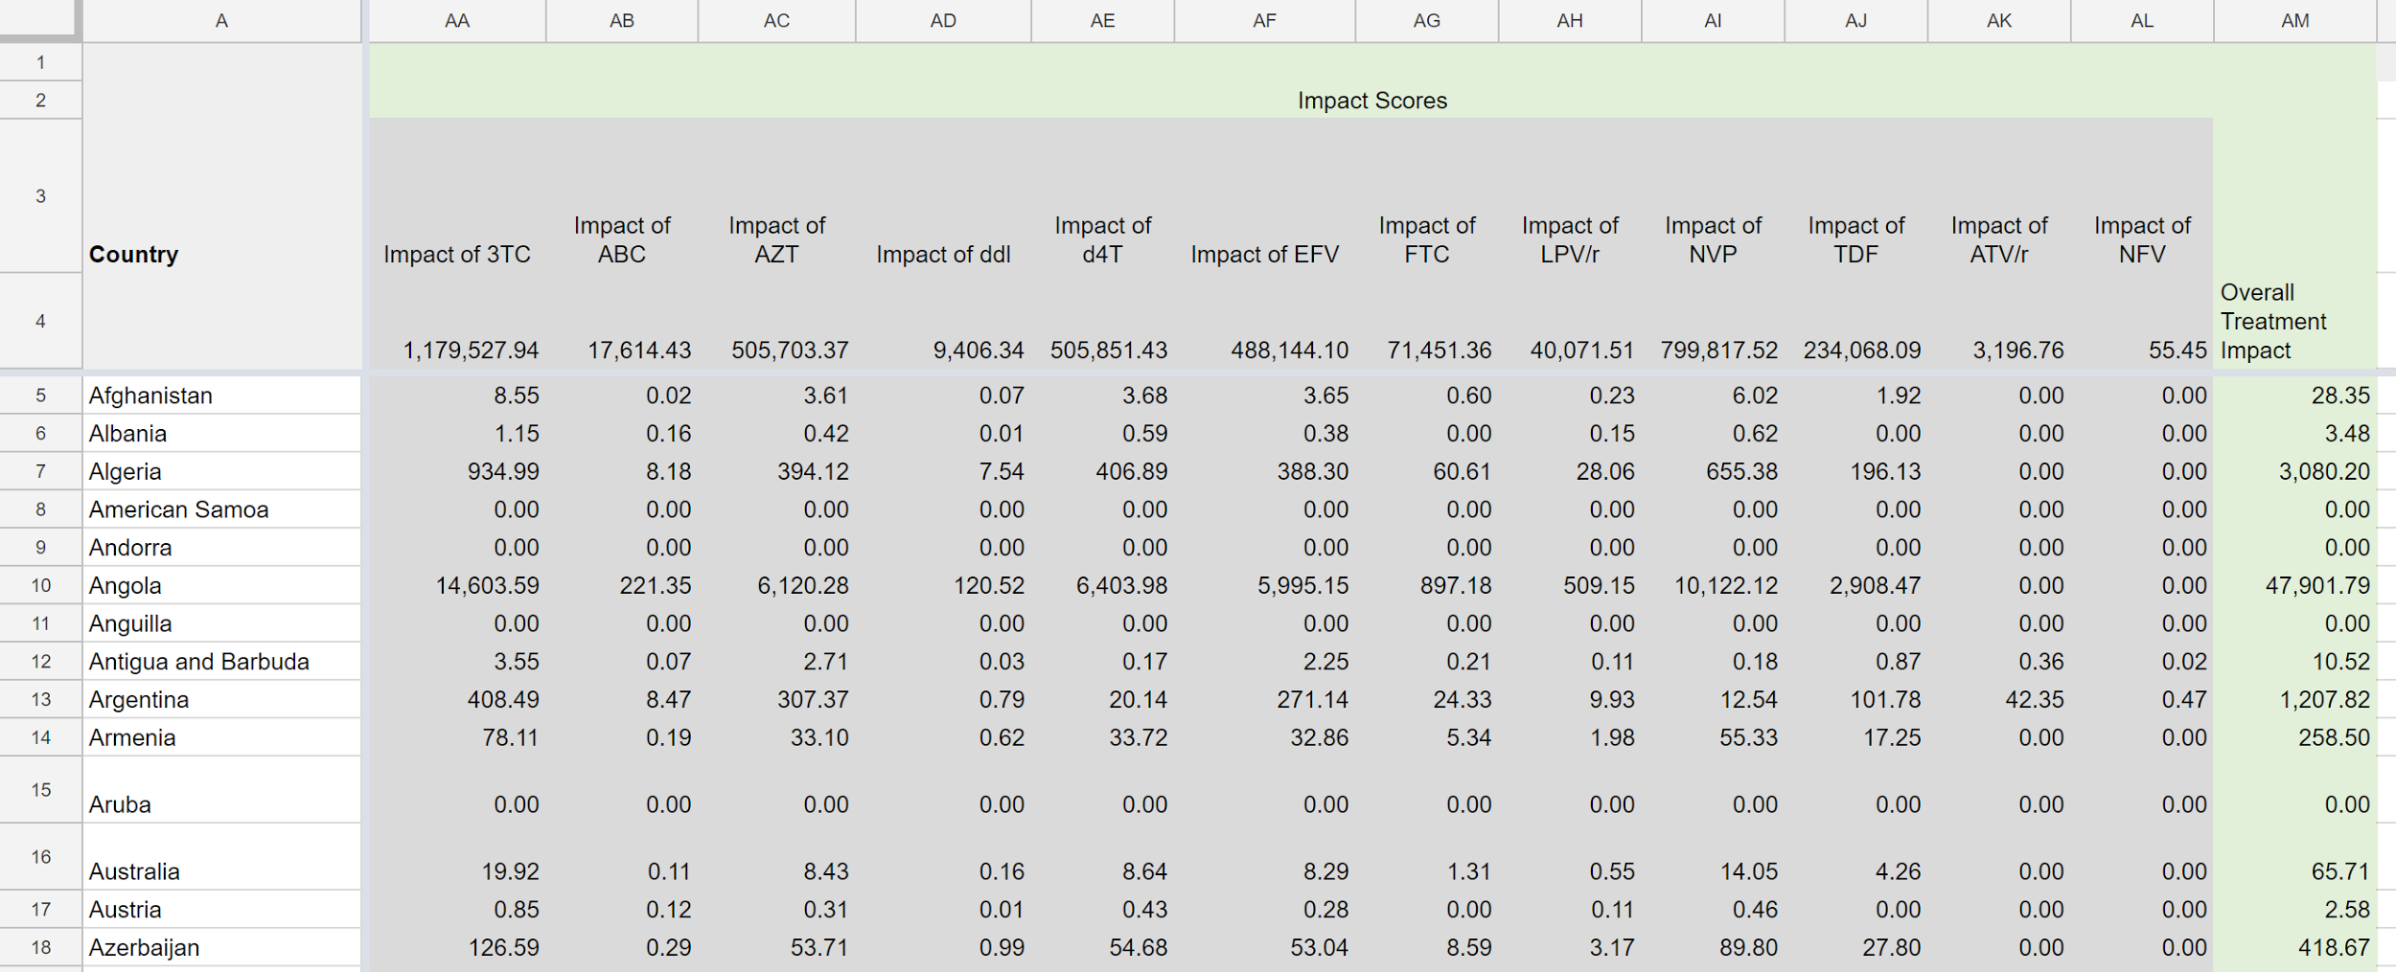
Impact Data
Column AA-AL: Impact Score per Drug
Row 4: Total Impact Sum
Column AM: Overall Treatment Impact per Country
Impact Formula for Drug X= D*θ*E/(1-θ*E)
In addition, we must multiply three variables:
Percentage of adult/children using 1st,2nd or 3rd line regiment (Columns AS-AT)
Proportion of adults/children using regiment Y that has drug X (Column AW/AZ depending on country Group)
Efficacy of regiment Y that holds drug X (Column AX/BA depending on country Group)

Slide 19
Example: Impact Score for d4T in Afghanistan
Afghanistan (Group A, Region EMR)
Adult DALY
Cell G5: 21,733.66
Adult Treatment Coverage
Cell S5= 4.29%
Children DALY
Cell H5: 2307.78
Child Treatment Coverage
Cell V5= 0.18%

Slide 20
Summary of Regiments Using d4T for Group A
ADULTS | Cell | combination | Cell | proportion | Cell | efficacy | Cell
First-line (97.10%) | AS6 | d4T+3Tc+NVP | AV7 | 27.7% | AW7 | 69.65% | AX7
 |  | d4T+3TC+EFV | AV9 | 14.00% | AW9 | 77.50% | AX9
Second-line(2.9%) | AS7 | d4T+3TC+LPV/r | AV25 | 1.9% | AW25 | 60.50% | AX25
Children |  | combination |  | proportion |  | efficacy
First-line (96.80%) | AS11 | d4T+3TC+NVP | AV31 | 34.9% | AW31 | 44% | AX31
 |  | d4T+3TC+EFV | AV33 | 15.6% | AW33 | 77.5% | AX33
 |  | d4T+3TC+LPV/r | AV36 | 5.9% | AW36 | 62% | AX36
Second-line (3.2%) | AS12 | d4T+3TC+LPV/r | AV47 | 4.6% | AW47 | 60.5% | AX47
 |  | d4T+3TC+ABC | AV50 | 1.4% | AW50 | 65.34% | AX50

Slide 21
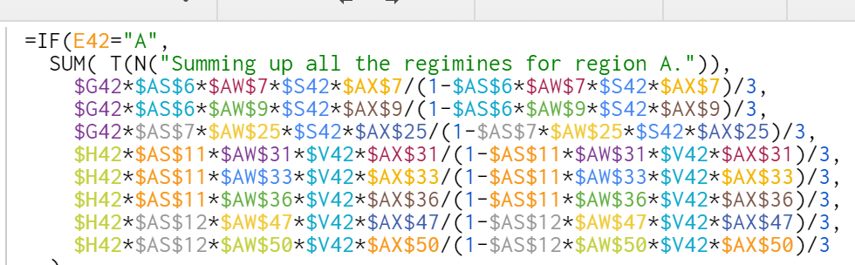
Divide by 3 since d4T is one of 3 drugs in each regiment. Assume that the impact is evenly divided among the drugs.
DALY | Regiment % | Proportion of Regiment | Treatment Coverage | Efficacy
Adult (G42) Children (H42) | Adult 1st Line (AS6) Adult 2nd Line (AS7) Children 1st Line (AS11) Children 2nd Line (AS12) | d4T+3Tc+NVP (AW7) d4T+3TC+EFV (AW9) d4T+3TC+LPV/r (AW25) d4T+3TC+NVP (AW31) d4T+3TC+EFV (AW33) d4T+3TC+LPV/r (AW36) d4T+3TC+LPV/r (AW47) d4T+3TC+ABC (AW50) | Adult (S42) Children (V42) | AX7 AX9 AX25 AX31 AX33 AX36 AX47 AX50

Slide 22
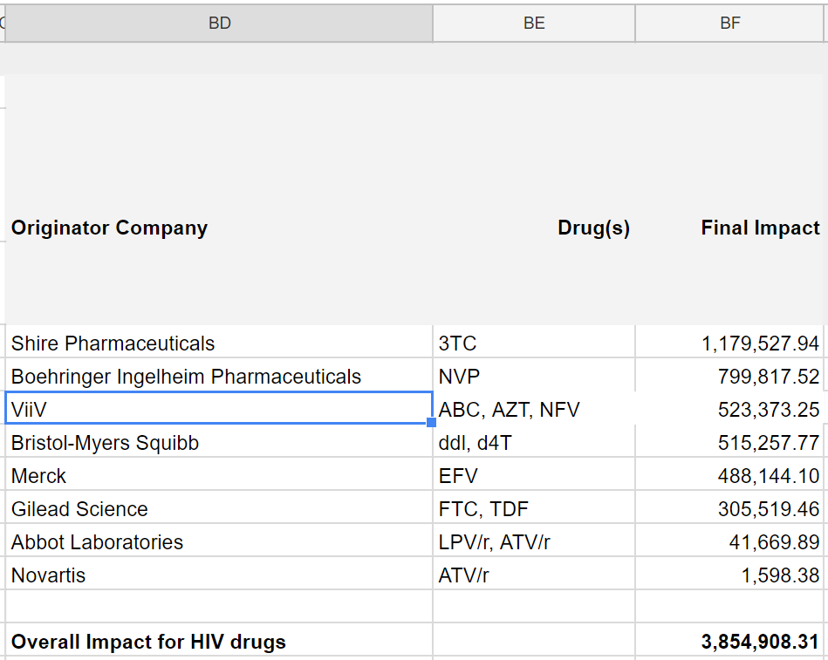
Company Rankings
Column BD: Originator Company
Column BE: Drug Patented by Company
Column BF: Final Impact of Company and Overall Impact for HIV Drugs
E.g: ViiV provides their patented drugs ABC, AZT and NFV. The sum of the impacts of those specific drugs (=($AB$4+$AC$4)+$AL$4), is the impact that ViiV has on global HIV drug treatment. According to the model, ViiV saves 523,373.25 years with its patented drugs, and ranks third on the list.

